Slide 1
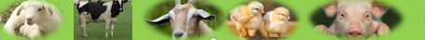
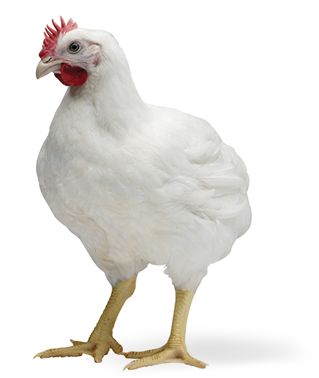
Broiler Production and Management
Michael Luwe
Veterinarian
Department of Animal Health and Livestock Development

Slide 2
Broiler Production and Management
Common Strains of Broiler in Malawi
Cobb 500
Indian River
Ross
Strains specifically developed for meat after several crossings of different breeds.
Normally reach average weight of 2kg between 6 – 8weeks.
Feed to weight gain ratio is 2:1

Slide 3
Limits to Broiler Growth and Quality

Slide 4
Housing
Type of housing: The deep litter system is commonly used because it is economical, comfortable for birds, and easy to manage.
Site: The poultry house should be positioned to benefit from prevailing winds and proper sun direction for good ventilation and temperature control.
Set-up: Houses should be arranged to allow movement and waste flow from younger to older birds to reduce disease spread.
Distance from older birds: Brooder houses should be at least 90 metres away from older birds to improve biosecurity.
Floor: Floors can be concrete or mud, provided they are dry, strong, and easy to maintain.
Roof: Roofing may be grass-thatched or iron sheets with a 0.8 m overhang to protect birds from rain and heat.
Stocking density: Maintain 10 birds per square metre to avoid overcrowding and promote good growth.

Slide 5
Housing
The width for small-scale farmers’ houses must not exceed 9m with a height of up to 3m.
Provide a screen to cover the sides in case of rain or sun and wire netting for proper ventilation and to keep predators away.
Ensure that the house is adequately ventilated.
Fresh and dry litter must be provided and its depth should be 8 – 10cm. The litter can be from wood shavings, rice hulls, g/nuts hulls, saw dust, maize cobs, or chopped maize stover.
All old litter must be removed and discarded before bringing in a new batch.

Slide 6
Guiding Principle on Management System
Practice ALL-IN, ALL-OUT system
Keep birds of same age at one point
Raise bird to slaughter weight in six weeks
Have two weeks rest between batches
Five batches can be kept in one year

Slide 7
Chick Qualities and Pre-placement
Collect chick which are of uniform size and colour.
Chicks should be alert and active with round and bright eyes.
The shanks should be bright and waxy.
Chicks should not have any deformities
They should be free from unhealed navels and navel infection.
They should not have a pasted up vent which is an indicator of diarrhoea.
Ensure that everything is ready before collecting the chicks and pre-heat the brooding house.

Slide 8
Chick Placement
Remove the dead ones and bury or burn them
Check the condition of the chicks and cull all deformed and sick ones
Check heating system
Introduce the chicks to water
Thereafter, introduce them to feed on trays or newspapers.
Provide vitamins in water the first 3 days.

Slide 9
Lighting Programme
Most small-scale farmers rely on day light only hence failing to raise them to 2kg.
Common practice to give the chicks 24hours of light in the first 2 to 3 days after arrival.
Thereafter, follow hatchery’s recommended lighting programme.
Lighting programmes vary but ensure that birds have at least 6 hours of darkness per day during their life and reduce the dark hours at least 5 days before slaughter.
Notes:
Energy is conserved during resting, leading to an improvement in feed conversion.
Growth rate can be equal to or better than that of birds reared on continuous light when compensatory gain is attained.
Lighting programs designed to prevent excessive growth between 7 and 21 days have been shown to reduce mortality due to ascites, sudden death, leg problems and spiking mortality.

Slide 10
Brooding Management
Two basic systems are used for brooding broiler chicks:
Spot brooding – the heat source is local and chicks can move away to cooler areas thus select for themselves a preferred temperature
Whole-House brooding – the heat source is larger and more widely spread so chicks are less able to move to select a preferred temperature.
Spot brooding is commonly practised amongst small-scale producers.
Practically, most small-scale farmers do not have brooders. Same house used for whole production process.
Notes:
In whole-house brooding, there is no temperature gradient within the house, although supplementary brooders might also be provided. The main whole-house heat source can be direct or indirect (using hot air).

Slide 11
Brooding Management
Sources of heat: charcoal burner, electric lamps, infra-red light, etc.
Young chicks are highly susceptible to coldness
Temperature to be 35ºC on the first day and reduce it by 2.8ºC every week until 26 - 28ºC by third week.
Monitor temperature using thermometer or chick’s behaviour.
Feed should be introduced on a tray or newspaper and this can be discontinued 3 – 5days later when the chicks are able to locate the feeders.
Notes:
Chicks cannot regulate their own body temperature until they are around 12-14 days of age. Optimal body temperature must be attained through provision of optimal environmental temperature.

Slide 12
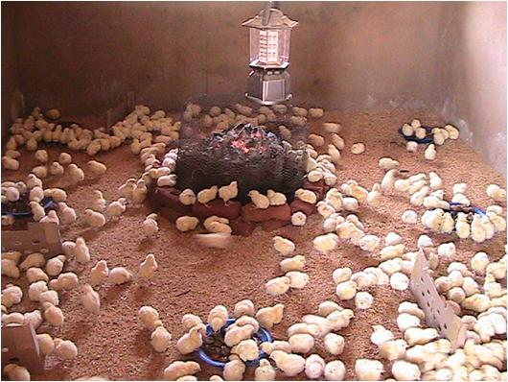
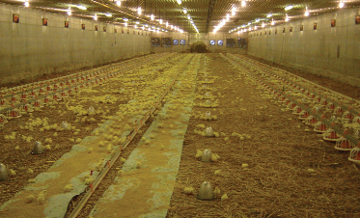
Brooding Systems
Spot brooding system
Whole-House brooding system
Notes:
Chick behaviour is the best indicator of correct brooder temperature. With spot brooding, correct temperature is indicated by chicks being evenly spread throughout the brooding area

Slide 13
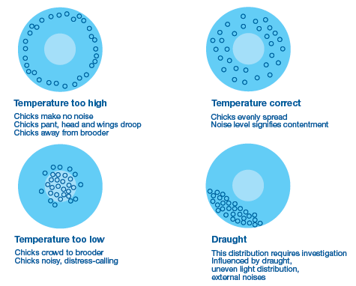
Response of Chicks to Brooder Temperatures
© Ross Broiler Manual

Slide 14
Brooding Management
Feeders and waterers should be strategically positioned to facilitate normal distribution of chicks thus avoiding overcrowding.
Check crop fill 6 and 24hours after placement.
Expand the brooder guard as the chicks grow.
Thereafter, remove the brooder guard and heat source depending on chick growth and season.
Brooding can take 10 – 14 days of age.

Slide 15
Feeding and Water supply
Feed and water troughs should be cleaned regularly
There must be ad lib provision of feed and cool and clean water in order to achieve rapid growth.
Feed should be fresh and no accumulation of feed should be allowed at the bottom of the trough.
Recommended trough space is as follows:
1 to 3 weeks: 2.5cm/bird
4 weeks above: 6cm/bird
No bird should walk more than 3 metres for food and water.

Slide 16
Feeding and Water supply
Feeders should not be filled more than two-thirds full to avoid wastage.
Feeders and drinkers should be gradually raised to the level of the birds’ backs as they grow to reduce wastage.
Insufficient feeding space will reduce growth rates and cause poor uniformity.
Without adequate water intake, feed consumption will decline and bird performance will be compromised.

Slide 17
Feeding Regimes
Two feeding regime:
Broiler Starter ~ 0 – 3 weeks (1.5kgs)
Broiler Finisher ~ 3 weeks – point of sale (2.5kgs)
Three feeding regime:
Broiler Starter ~ 0 – 2 weeks (1kg)
Broiler Grower ~ 2 – 4 weeks (1.5kgs)
Broiler Finisher ~ 4 weeks – point of sale (1.5kgs)

Slide 18

Forms of Feed and Feed Quality
Broiler growth and efficiency of feed use will generally be better if the Starter feed is crumbs or mini-pellets, and the Grower and Finisher feeds are pellets.
Depending on pellet size fed, it may be necessary to provide the first delivery of Grower feed as crumbs or mini-pellets.
Form of Feed by Age in Broilers
Source: Ross Broiler Manual, 2009

Slide 19
Litter Quality
Litter quality directly affects the health of the bird.
Important functions of litter include the ability:
To absorb moisture.
To dilute excreta, thus minimizing bird to manure contact.
To provide an insulation from cold floor temperatures
Lower moisture levels in the litter reduce the amount of ammonia in the atmosphere, which helps reduce respiratory stress. Foot pad dermatitis incidence is reduced if litter quality is good.
Replace or turn litter regularly to ensure that the litter is always dry.

Slide 20
Temperature and Ventilation
Ensure that temperatures are between 20 and 25 ºC.
High temperatures are associated with reduced feed intake.
The main purpose of minimum ventilation is to provide good air quality - adequate oxygen, optimum relative humidity and minimum amounts of carbon dioxide, carbon monoxide, ammonia and dust.
Always evaluate ammonia (NH₃) levels at bird height.
The negative effects of NH₃ include:
foot pad burns,
eye burns,
breast blisters/skin irritations,
decreased weights,
poor uniformity,
disease susceptibility and
blindness.

Slide 21
Health
On-farm disease control programmes involve:
Disease prevention.
Early detection of ill health.
Treatment of identified disease conditions.
Biosecurity and vaccination are both integral to successful health management.
Vaccination alone cannot protect flocks against overwhelming disease challenges and poor management practices.

Slide 22
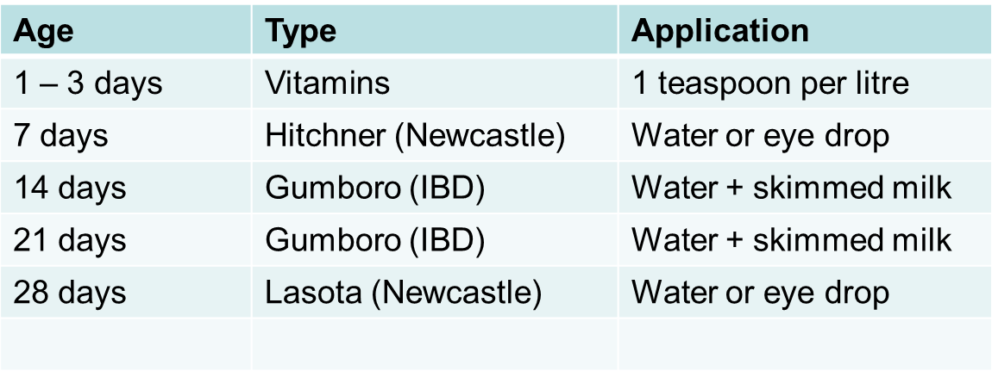
Vaccination and Medications
Use unchlorinated water when administering vaccines.

Slide 23
Cleaning and Disinfection
Bacteria and viruses can persist in an environment for months or even years if its in organic matter.
Clean the house 2 – 3 weeks before the first or next batch arrives.
Remove all dirt and cobwebs
Some of the disinfectants used: Sodium hypochlorite, formalin, potassium permanganate.

Slide 24
Record Keeping
It is vital that a farmer should keep accurate records.
Chick placement: number of day old chicks, date and time of arrival, chick quality, source.
Mortality: daily, weekly, cumulative
Medication: date, amount and batch number
Vaccinations: date, vaccine type, batch number, expiry date
Feed: date of delivery, quantity, feed type, date of starting feed withdrawal
Live weight: weekly live weight

